Slide 1
Book store in UK: FINAL presentation
Group 8:
Oksana Kuļčihina
Darja Jafanova
Anna Lihušina
Jelena Zujeva
Alina Verkholomova
Mārtiņš Grišāns

Slide 2
Website Development

Slide 3
User-friendly design
Intuitive Navigation
Website has a clear, logical structure and includes a top menu bar with categories like "Home," "Shop," "About Us," "Contact," and "Cart."
Tasks
User-Friendly Design
Search Functionality
Robust search bar allowing users to quickly find specific books or categories.
Schedules
Consistent Layout
Consistent layout across all pages to avoid confusion. Also, engaging fonts, and a color scheme that reflects the brand identity..

Slide 4
Responsive design
Mobile
Optimization
Website is adapted seamlessly to various screen sizes and devices, including smartphones and tablets.
Tasks
User-Friendly Design
Search Functionality
Responsive Design
Responsive and high-quality images that adjust to different screen resolutions and orientations are used.
Visual Appeal
Consistent Layout
Fluid Grid Layout
Implement a fluid grid layout that adjusts content to fit any screen size.

Slide 5
Fast load times
Image Optimization
Compress images without losing quality to reduce load times.
Tasks
Management Objectives
Fast Load Times
Minimize HTTP Requests
Combine files where possible to reduce the number of HTTP requests.
Schedules
Project Objectives
Enable Browser Caching
Customer Objectives
Store certain data locally in users' browsers to speed up repeat visits.

Slide 6
User-frcall-to-actions
Call-to-Actions are placed prominently on the homepage, product pages, and throughout the site where users are most likely to take action.
Strategic Placement
User-Friendly Design
Search Functionality
Clear Call-to-Actions
Сlear and compelling language is used to encourage clicks (e.g., "Buy Now," "Sign Up," "Learn More").
Visual Appeal
Consistent Layout
Contrasting Colors
Design is with colors that stand out from the rest of the page to draw attention.

Slide 7
Analytics integration
Google Analytics Setup
Implement Google Analytics to track visitor behavior, such as page views, time spent on site, and conversion rates.
Tasks
Management Objectives
Analytics Integration
E-commerce Tracking
Set up e-commerce tracking to monitor sales performance and user interaction with the shopping cart and checkout process.
Project Objectives
Schedules
Regular Reporting
Generate regular reports to analyze data and make informed decisions about website improvements.

Slide 8
Secure and Trustworthy
HTTPS to encrypt data and ensure a secure connection between the user and the website.
HTTPS Protocol
+ Clearly state the privacy policy to inform users about data collection and usage practices.
Tasks
User-Friendly Design
Search Functionality
Trust badges are displayed from recognized security providers on the homepage and during the checkout process to build user confidence.
Secure and Trustworthy
Visual Appeal
Consistent Layout
Ensure the checkout process is secure, using SSL certificates and other encryption methods to protect user information.
Secure Checkout

Slide 9
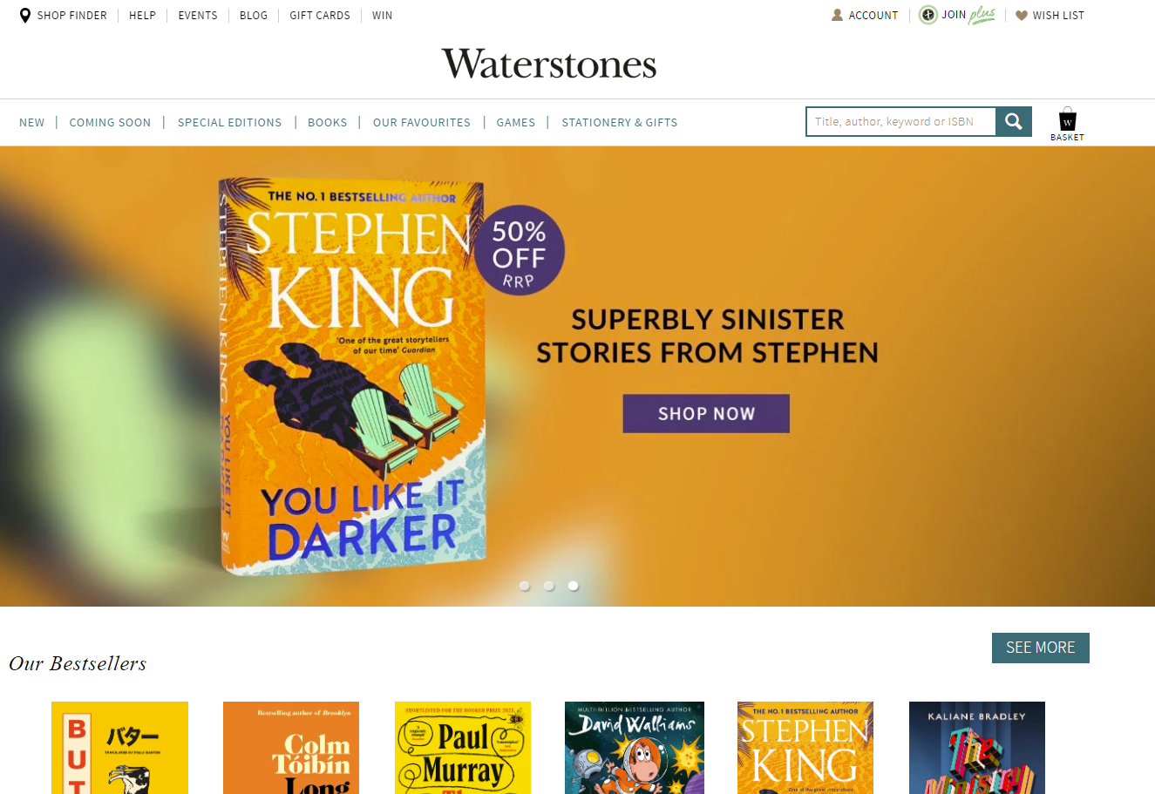
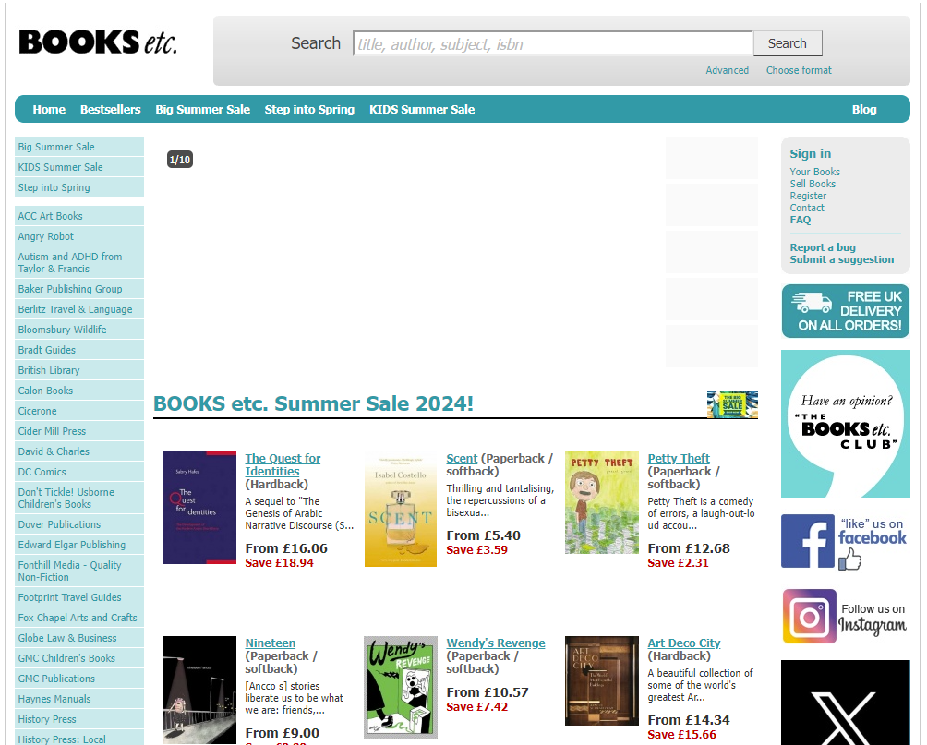
Good example
Bad example

Slide 10
Search Engine Optimization (SEO)

Slide 11
Keyword Research
List of keywords with higher monthly searches and low competition, as provided by Google Keyword Planner
Keyword | Avg. monthly searches | Competition
reading | 500000 | Low
drama cool | 500000 | Low
dramacools | 500000 | Low
thriller | 50000 | Low
crime | 50000 | Low
drama | 50000 | Low
spotify audiobooks | 50000 | Low
unforgotten | 50000 | Low
broadchurch | 50000 | Low
kdrama | 50000 | Low
... | ... | ...
Focusing on long-tail keywords specific to the bookstore, such as “best fantasy novels,” “rare book collection,” or “children’s picture books” and on broad keywords, such as “reading”, “thriller​”, “crime​” and “drama”​. However, Google Keyword Planner provided statistics shows, that the broad keywords have more monthly searches and lower competition.

Slide 12
On-Page SEO
Title Tag: Thrilling Drama Reads | In Black & White Bookstore
Meta Description: “Discover captivating stories at In Black & White Bookstore in the UK.
From chilling thrillers to vibrant drama. Join our cool book club!”
Headers:
“A Haven for Book Lovers: Exploring the Cozy Corners of Bookstores”
“Page-Turners: Unraveling the Mystery in Thriller Novels”
“The Drama of Words: A Literary Exploration”
Image Alt Text: Add descriptive alt text to images, including relevant keywords (reading, thriller, crime, drama)

Slide 13
Technical SEO
Clean URL Structure
www.inblackandwhite.co.uk
www.inblackandwhite.co.uk/thriller
www.inblackandwhite.co.uk/crime
www.inblackandwhite.co.uk/drama
Fast Load Times: Optimize images, use browser caching, and minimize server response
time.
Mobile-Friendly Design: create a website for mobile devices.
XML Sitemap: Create an XML sitemap and submit it to search engines (e.g., Google Search
Console).
Robots.txt: Use a robots.txt file to control which pages search engines can crawl.

Slide 14
On-Page SEO
Title Tag: Thrilling Drama Reads | In Black & White Bookstore
Meta Description: “Discover captivating stories at In Black & White Bookstore in the UK.
From chilling thrillers to vibrant drama. Join our cool book club!”
Headers:
“A Haven for Book Lovers: Exploring the Cozy Corners of Bookstores”
“Page-Turners: Unraveling the Mystery in Thriller Novels”
“The Drama of Words: A Literary Exploration”
Image Alt Text: Add descriptive alt text to images, including relevant keywords (reading, thriller, crime, drama)

Slide 15
Link building
strategies
Link Building Strategies
Tasks
High-Quality and Engaging Content Creation
Guest Posting on Relevant Websites
Direct Outreach to Websites
Utilizing Social Media Platforms
Schedules
Project Objectives
Utilize various content formats such as page posts, infographics, videos, podcasts, ebooks, and case studies to attract a broad audience and encourage sharing.
Include a link to the In Black & White Bookstore page in the author bio or within the guest post to drive traffic and enhance credibility.
Establishing connections with relevant website owners can lead to long-term backlink opportunities and collaborations.
Social media activity enhances social signals, which can positively influence the page's ranking on Search Engine Results Pages

Slide 16
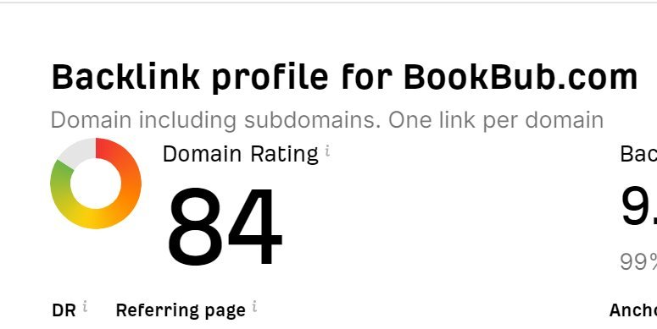
Link Building Pages​
BookBub.com is a book discovery service, that was created to help readers find new books and authors.​
Booksellers.org.uk - the Booksellers Association is a membership organisation for all booksellers in the UK & Ireland, representing over 95% of bookshops. ​
SmartBlogger.com is one of the world’s largest sites dedicated to writing and blogging. ​

Slide 17
Paid Advertisements

Slide 18
BUDGET
Platform | Monthly Budget Allocation | Goal(s) | Metrics
Google Ads | €3,600 | Conversions, Sales | Conversion rate, ROAS
Facebook Ads | €2,700 | Brand Awareness, Lead Generation | Impressions, CPL, lead conversion rate
Instagram Ads | €1,800 | Brand Awareness, Engagement | Reach, engagement rate LinkedIn
LinkedIn Ads | €900 | Lead Generation, B2B Sales | Number of leads, cost per lead
Total | €9,000

Slide 19
Ad CreaTIon
Platform | Ad copy | Visuals
Google Ads | "Find Your Next Great Read with Our Extensive Collection. Shop Now!" | High-resolution book cover images, clear CTA
Facebook Ads | "Explore Our Latest Book Arrivals and Special Offers!" | Engaging videos showcasing popular books
Instagram Ads | "Discover the Best Books for Every Genre. Start Reading Today!" | Eye-catching images of books in lifestyle settings
LinkedIn Ads | "Professional Reads for Your Business Needs. Learn More!" | Professional images and infographics

Slide 20
targeting
Google Analytics Setup
Targeting
Tasks
Google Ads
Facebook Ads
Instagram Ads
LinkedIn Ads
Schedules
Project Objectives
Keywords related to books, genres, and authors, retargeting past website visitors
Interests in literature, age group 25-55, custom audiences from email lists.
Interests in reading, age group 18-45, retargeting Instagram engagement
Job titles (e.g., Managers, Executives), industries (e.g., Publishing, Education), company size

Slide 21
Tracking & analytics
Track website traffic, source/medium, and
conversions
Google Ads
User-Friendly Design
Search Functionality
Measure actions taken on the website after viewing the ad
Facebook Ads
Tracking & Analytics
Consistent Layout
Review metrics such as CTR, conversion rates, cost per conversion and ROAS
Monthly reportnig

Slide 22
A/B TesTIng
Platform | Test Details | Outcome
Google Ads | Two different headlines ("Find Your Next Great Read" vs. "Discover Bestsellers") | Measure which headline drives more clicks and conversions
Facebook Ads | Static image vs. video ad | Determine which format generates higher engagement
Instagram Ads | Different CTAs ("Shop Now" vs. "Start Reading Today") | Identify which CTA leads to more conversions
LinkedIn Ads | Infographic vs. product image | Assess which visual type resonates more with the audience

Slide 23
Social Media Marketing

Slide 24



Platform Selection
Facebook: Broad audience, great for sharing promos, and engaging with a community.​
Instagram: Visual platform ideal for books, reading spaces, and user-generated content.​
Twitter: Useful for quick updates and participating in trending topics.​
Reddit: Communities for active book lovers where users can discuss literature freely.​
YouTube: Perfect for book reviews, author interviews, and unboxing videos.​

Slide 25
Content Calendar (example)​
Day | Platform | Content
Monday | Instagram | Post: Aesthetic photo of a book stack with a caption about starting the week with new reads. Stories: Quick poll asking followers what genre they're reading this week.
 | Facebook | Post: “Book of the Week” announcement with a detailed review and link to purchase. Live Video: Brief introduction to the book and why it’s the pick of the week.
 | YouTube | Video: Weekly book recommendations (5-7 minutes), focusing on new arrivals.
 | Twitter | Tweet: “New week, new reads! Check out our latest arrivals. [link]” Poll: “Which genre are you diving into this week? #MondayReads”
 | Reddit | Post: Discussion thread in a book-related subreddit about the community’s current reads.

Slide 26
Engagement
Facebook:
Interactive Posts: Create polls or quizzes related to popular books or genres.
Community Groups: Create and manage book club groups for discussions.
Instagram:
Stories: Use polls, quizzes, and stickers in Instagram Stories to engage with followers.
Reels: Create short, engaging videos showcasing new arrivals, book reviews, or behind-the-scenes content.
Contests and Giveaways: Organize photo contests or book giveaways to boost engagement and attract new followers.
YouTube:
Author Interviews: Publish in-depth interviews with authors discussing their latest works.
Live Readings: Host live reading sessions of popular books or new releases.
Twitter:
Book Jokes: Share humorous book-related jokes or memes to entertain followers.
Announcements: Post updates about upcoming events or special promotions.
Reddit:
Discussion Threads: Create threads for discussing the latest books or reading lists.
Recommendations: Share lists of books based on different themes or genres.

Slide 27
Influencers Partherships
BookTubers
(YouTube Book Influencers)
Bookstagrammers (Instagram Book Influencers)
How to Partner: Sponsored reviews, Reading Challenges,
Contests ​
How to Partner: Instagram Takeovers, Feature Posts, Book Club Events
INFLUENCES PARTNERSHIP
Podcast Hosts
Sprint Retrospective
How to Partner: Podcast Sponsorships, Author Interviews​
How to Partner: Discussion Threads

Slide 28
Key Metrics​
Engagement Metrics: ​
Likes, Shares, Comments: Measure how often users interact with your posts.​
Engagement Rate: The percentage of your audience that engages with your content. This includes | likes, shares, comments, and other interactions.​
Reach and Impressions:​
Reach: The number of unique users who see your content.​
Impressions: The total number of times your content is displayed, regardless of whether it is clicked or not.​
Follower Growth: Track the increase or decrease in your followers over time.​
Click-Through Rate (CTR): The percentage of users who click on a link in your post to visit your website or landing page.​

Slide 29
Analytics Tools​
Facebook Business Suite​
Instagram App (Professional Account)​
Twitter Analytics​
YouTube Studio​
Reddit's own analytics (Reddit Insights) and third-party tools like Later

Slide 30
Content Marketing

Slide 31
Content strategy
Content creation:​
Blog Posts: Regularly updated articles related to industry trends, how-to guides, case studies, etc.​
Videos: Engaging and informative videos that can be shared on platforms like YouTube or social media.​
Infographics: Visual representations of information or data to make complex information easily understandable.​
Podcasts: Audio content that can reach audiences who prefer listening over reading.​
E-books/Whitepapers: In-depth guides or reports on specific topics, often used for lead generation.​
Social Media Posts: Short, engaging content shared on platforms like Facebook, Twitter, Reddit, Instagram, etc.
Content creation must be well planned Using content Calendar.​
In additional, it must be created on specific date​
Before each important occasion (Christmas, St.Valentine day, Independency day) additional/special post must be prepared with selection of books​
Day of the week and time​
The largest engagements can be reached on Tuesdays, Wednesdays and Thursdays between 9am and 2pm depending of a platform.

Slide 32
Quality content
To reach the quality standards must be maintained the quality use of:​
Editorial standards:​
Develop a comprehensive style guide covering tone, formatting, and style.​
Implement a multi-step review process including peer reviews and editor oversight.​
Visuals:​
Use high-resolution images and videos, ensuring they are relevant and enhance the content.​
Integrate interactive elements like quizzes and polls to increase engagement.​

Slide 33
Buyer persons
Academic Alex​ | Literary Lucy​ | Family Fiona​ | Retired Richard​
Age: 18-24​ Occupation: University student​ Location: University towns (e.g., Oxford, Cambridge, Leeds)​ Income Level: Limited, mainly from part-time jobs or parental support​ Education: Currently pursuing a degree​ Reading Habits:​ Focused on academic texts, textbooks, and research materials​ Enjoys non-fiction and classics for leisure reading​ Shopping Preferences:​ Buys both new and second-hand books​ Uses online platforms for convenience and price comparison​ Participates in student discount programs​ Pain Points:​ High cost of textbooks and academic materials​ Finding reliable sources for second-hand books​ Marketing Channels​ University bulletin boards and online student communities​ Student discount programs and loyalty schemes​ Academic conferences and events​ | Age: 25-35​ Occupation: Young professional, often in creative or academic fields​ Location: Urban areas (e.g., London, Manchester, Edinburgh)​ Income Level: £30,000 - £50,000 annually​ Education: University degree, often with postgraduate education​ Reading Habits:​ Prefers contemporary fiction, literary fiction, and non-fiction (biographies, memoirs)​ Interested in book clubs and author events​ Shopping Preferences:​ Buys books both in-store and online​ Enjoys browsing and discovering new authors​ Appreciates personalized recommendations​ Pain Points:​ Limited time for reading due to busy lifestyle​ Overwhelmed by the volume of new releases​ Prefers sustainable and ethically sourced books​ Marketing Channels:​ Social media (Instagram, Twitter)​ Email newsletters with curated book lists​ Literary blogs and online magazines​ ​ | Age: 35-45​ Occupation: Part-time professional or stay-at-home parent​ Location: Suburban or small-town areas​ Income Level: £40,000 - £60,000 annually (household)​ Education: University degree​ Reading Habits:​ Buys children's books, parenting guides, and popular fiction​ Looks for educational and entertaining books for children​ Shopping Preferences:​ Prefers in-store shopping to allow children to choose books​ Values recommendations from staff for age-appropriate books​ Looks for discounts and sales, especially for children’s books​ Pain Points:​ Finding books that interest children and encourage reading​ Managing budget for family reading materials​ Marketing Channels:​ Parenting forums and websites​ Community events and local advertising​ Family-oriented social media groups​ ​ | Age: 65+​ Occupation: Retired​ Location: Rural or coastal areas​ Income Level: £20,000 - £30,000 annually (pension)​ Education: Secondary education, some with higher education​ Reading Habits:​ Prefers historical fiction, mystery novels, and non-fiction (history, travel)​ Enjoys large-print books and audiobooks​ Shopping Preferences:​ Favors local, independent bookstores​ Appreciates personal interaction with knowledgeable staff​ Interested in book-related events and social activities​ Pain Points:​ Limited mobility and access to bookstores​ Prefers books that are easy to read (large print)​ Marketing Channels:​ Local newspapers and radio​ Direct mail catalogues​ Community centers and clubs​ ​

Slide 34
CONTENT DISTRIBUTION
Social media: develop a social media calendar and create the platform-specific content. Engage with followers through comments, shares, and direct messages.
Email marketing: build and segment email list to target different audience groups. Use email marketing platform to design and send newsletters, including call-to-actions and personalized content emails..​
Partnership: collaborate with influencers and industry publications for guests posts and join campaigns.
Content syndication: syndicate content on platform like Medim or Reddit and industry-specific sited. Use tags to avoid duplicates. ​
Community engagement: Participate in relevant online forums and groups such as Goodreads and Reddit.

Slide 35
Repurposing Content
Adapt existing content into various formats to extend its reach, increase engagement, and maximize the return on investment (ROI).
Steps to repurpose the content:
Identify high-performing content using the Analytic tool
2. Use repurpose techniques:
Blog to Vide
Blog to Infographic
Video to Blog Post
Podcast to Blog Post
Infographic to Social Media Posts
E-books/Whitepapers to Articles
3. Evaluate the result
4. Continue improvement

Slide 36
Email Marketing

Slide 37
Email List Building​
Three sign-up forms integrated into the website.
Two developed lead magnet campaigns.
Social media campaigns.
One giveaway with social media integration.
Sign-up Forms – Omnisend.
Lead Magnets – free eBooks, discounts, sales, or free shipping.
Social Media Integration – Facebook Lead Ads, Instagram.
Offer Giveaways- Rafflecopter

Slide 38
Email Campaigns​
Use a recognizable sender name.​
Customize the recipient “to” name​
Craft a benefit-focused subject line and pre-header text.​
Apply our branding (logo, brand colors and fonts) ​
Use images.​
Follow email or spam regulations.​
Mobile-friendly and appealing design.
Weekly emails featuring new books.​
Monthly emails showcasing bestsellers.
HubSpot Email Marketing tool

Slide 39
Automation
Welcome Email Series introducing the bookstore and offering a discount on the first purchase.​
1
Abandoned Cart Email reminding subscribers they left some items in their cart.
2
Birthday Emails sending personalized greetings and special offers.
3
Post-Purchase Thank You Emails.
4

Slide 40
segmentation
Audience should be segmented based on geography, genre preferences and purchase history.​
Expected deliverables:​
Monthly tailored book recommendation based on audience segmentation.
HubSpot Email Marketing tool

Slide 41

analytics
Bounce rate ​
Deliverability rate ​
Spam rate ​
Open rate
Conversion rate​
Unsubscribe rate.​
List growth rate.​
Return on investment
HubSpot Email Marketing tool

Slide 42
Thank you!

